Slide 1
Parallelizing the Time Series Analysis of Phenometrics and Long-Term Vegetation Trends for the Great Plains Ecoregion
David, Jacob, and Joe

Slide 2
Satellite Imaging Project
David, Jacob, and Joe

Slide 3
Goals
Process a time series of MOD13Q1 images to assess trends in grassland biomass production as measured with NDVI/EVI. Develop and approach to identify “anomalous” digital number values for this proxy to inform near real-time management.
Process time series of MOD13Q1 images to assess grassland phenology. Extract multiple phenometrics and assess their temporal trends and spatial variation over the period 2001-2017.
Develop a validation procedure for Objectives 1-2 using imagery from the PhenoCam Network.
Using an improved understanding of grassland development and production in the past, and forecasted into the future, assess the impact of changing grassland conditions on the provision of a subset of ecosystem services.

Slide 4
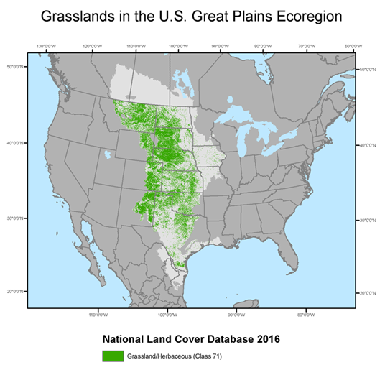
Goals TL;DR
Process the fancy satellite images to find a trend in how green the 15.5 acres it represents was
Process the same fancy images but this time we are trying to track the growth stages of the plants
Use the data from both 1 and 2 to help make sure ground readings are correct
Use all this data and forecast it to see how we impact the grasslands

Slide 5
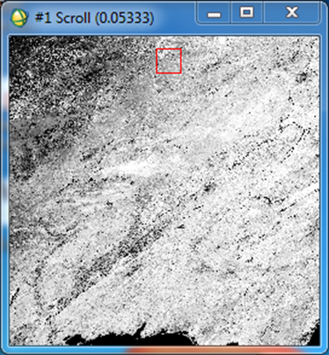
About those fancy space pictures
There are 422 tiles, or pixels, each of which contain values for a separate 250m x 250m area
This is 15.5 acres for anyone who cared about converting
6.2 Hectares, if anyone is still counting
Since 2001, there have been 23 images a year for each tile
This means we have 391 values for every data point measured in each tile
TL;DR is that there is consistent and reliable data over a long period of time

Slide 6
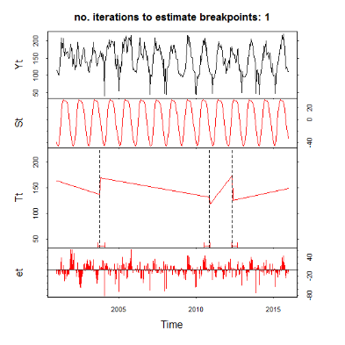
The Computer Part
Our task is to use an R package called BFAST
Stands for Breaks For Additive Season and Trend
This is the black box we have to run the data through
And hopefully make this part faster

Slide 7
Methods of Attack
Plan A - Easy - Manual Parallelization through scripts that allow all of the tiles to be submitted as jobs at the same time and allowing the scheduler to do the work
Plan B - Medium - Parallelize the R code using some of its built in functions
Plan C - Hard - Rewrite the whole thing, including BFast, in C, because we’re masochists

Slide 8
Plan A: Manual (Shell Script) Parallelization
The plan is to make a C program that generates a shell script for all the tile data files in the folder with the executable
The shell script then gets run which submits jobs for all 422 tile data files using their size to safely estimate how much time each should take to run
This allows him to run 2 things and have all of his data in Beocat waiting for the resources to run and not requiring him to run each jobs serially

Slide 9
Plan A: Manual (Shell Script) Parallelization
Some benefits of this method are that the R code is already written and minimal effort was required to have it take the filename as an argument
From this: “filename <- “tile_###”
To this: “args <- commandArgs(trailingOnly = TRUE); filename <- args[1]”
Another is that since each tile has its own job in the Beocat queue, if one fails he can re-submit only the failed job
The last benefit is that once the code is written, all he has to do is drag in the new tile data files and run the 2 files again
The length the code will take to run ranges from his original time of 5 months to the best case scenario of what should be under a week because every job would run at the same time and the total time would be however long the longest job takes
This means my speedup will be between 1 and 21
Otherwise, it depends, unfortunately not on caching and locality

Slide 10
Plan B: Common Sense (R) Parallelization
R has a function called lapply that takes in two parameters: a list and a function. Similar to a foreach, lapply calls the function once for each item in the list, passing a different item as the parameter in the function each time. This is done serially.
lapply(1:3, function(x) c(x, x^2, x^3))
[[1]]
[1] 1 1 1
[[2]]
[1] 2 4 8
[[3]]
[1] 3 9 27

Slide 11
Plan B: Common Sense (R) Parallelization
R has a package specifically for parallelization called... parallel (duh). This package can be used to basically lapply in parallel. The parallel version of lapply is called parLapply and takes in an additional argument, the number of cores.
library(parallel)
cluster <- makeCluster(#ofCores)
parLapply(cluster, 2:4, function(exponent) 2^exponent)
[[1]]
[1] 4
[[2]]
[1] 8
[[3]]
[1] 16

Slide 12
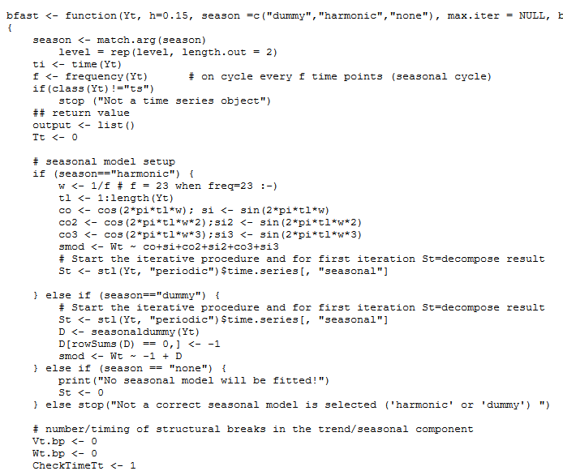
Plan C: Insane (Rewrite in C) Parallelization
BFast is Open Source
Made up of 14 .R files, each 10-150 lines
R is Compiled from C & Fortran
Potential 500x Speed-Up without Parallelizing
Notes:
https://www.sas.upenn.edu/~jesusfv/comparison_languages.pdf
A Comparison of Programming Languages in Economics, Univ. of Penn., Univ. of Maryland

Slide 13
Choosing a Plan
Dr. Hutchinson’s One Requirement:
He can read and operate it -> Plan A/B
Dr. Andresen’s More Important Requirement:
It has to be as fast as possible -> Plan C

Slide 14
Questions?

Slide 15
Sources
http://gforge.se/2015/02/how-to-go-parallel-in-r-basics-tips/
http://dept.stat.lsa.umich.edu/~jerrick/courses/stat701/notes/parallel.html
https://www.rdocumentation.org/packages/bfast/versions/1.5.7/topics/bfast
https://cran.r-project.org/web/packages/bfast/bfast.pdf
https://www.sas.upenn.edu/~jesusfv/comparison_languages.pdf
https://r-forge.r-project.org/scm/viewvc.php/?root=bfast

